Slide 1
Lake Nona High School
January 30, 2019

Slide 2
Intro
J.A. Sutherland & Richard Grantham
www.JaSutherlandBooks.com
Books
Focus on business, not craft
Why talk about money?
Talk about money

Slide 3
>100,000 copies sold since 11/2014
>90% read through rate (Book 2 to Book 3)
>$350,000 earnings (through 2018)

Slide 4
Caveat
“Everything said applies mostly to the speaker, their genre, their writing process, their books, their experience, and only to the best of their knowledge at that particular point in time, and may not be at all applicable to you, your process, your market, or your story.”
-- The disclaimer I wish would pop up over the speaker’s head at every writers’ workshop
Example:
Cut in editing

Slide 5
SCAMS
Money goes from publisher to author, not the other way around.
If a “publisher” asks for money, run.
There are legit self-publishing “packages”, but they’re few and far between and you’re better off finding good providers yourself.
https://www.sfwa.org/other-resources/for-authors/writer-beware/

Slide 6
You are running a business
Income/expenses
Taxes
Advertising/marketing
Self-published
Editors
Cover design
Contracts (and have reviewed by an attorney)

Slide 7
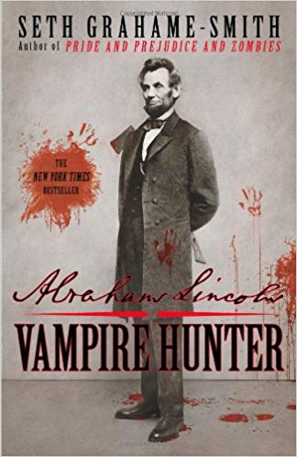
Contracts
2 book deal
$4 million advance
Example: Reserve against returns
www.kriswrites.com/2016/08/31/business-musings-a-real-book-contract-contractsdealbreakers/

Slide 8
Taxes and Storytelling
What does this have to do with storytelling?
Keep your receipts
Startup expenses

Slide 9
More Money
Fewer people are reading
Ebook sales “declining”
Ebook device sales “declining”

Slide 14
# of books
100 sales to match income
More books =
More entry points for new readers
More new releases
More visibility
More read through

Slide 15
Visibility

Slide 16
1000 words a day
300,000 words / year
3 – 100,000 word novels
Form the habit
Keep the habit
It’s hard.
Train yourself:
Specific time
Specific place
Train your brain “When we are here at this time we write words.”
It’s hard.

Slide 19
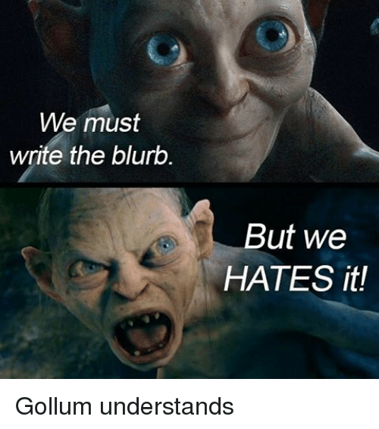
It’s hard.
The habit of writing is hard.
Editing is hard.
Marketing is hard.
Submitting to agents is hard.
Rejections/1-star reviews are hard.
Finding an editor is hard.
All of these are generally easier than most jobs.

Slide 20
Ideal Writing Life
6:00am Walk the dogs
6:30am Write 1000-2000 words
8:00am Breakfast
8:30am Another 1000 words
10:00am Another walk
11:00am Edit
12:00pm Go out (refill creative well)
A couple more hours of editing later in day.

Slide 21
Aside from money
Making a reader stay up all night.
Making a reader cry.

Slide 22
“One event in book 4 which actually brought tears to my eyes was the monument of names so Alexis could grieve and say goodbye.
It touched me because I had a similar experience with my Major. I did go to Arlington a few years back to say goodbye to my Major. Like Alexis it did bring some relief.
I loved my men very much and to lose them hurts very much, not to mention the worry because you sent them into harms way.
In my darker days I was racked with so much pain I could barely function. There were times it hurt to breathe. I still suffer with insomnia and fear of the dreams of combat, giving orders in combat, and losing my people but I try and work through them.”

Slide 23
“I just listened to your four book series with Alexis Carew on my grown sons' audible accounts.
As I've not been sleeping much I've had a lot of listening hours. Finding your books has been a God-send.
After 18 years of shrinks and their like telling me I have PTSD then describing symptoms I don't have I have now 'met' someone whose PTSD is so much like mine I don't feel different and alone in it. 100's of flesh and blood people in various 'therapy groups' never gave me the - I'm normal, my messed up stuff is normal messed up stuff- that your fiction has done.
THANK YOU”

Slide 24
Think about your favorite author.

Slide 28
How?
Set and keep your writing habits.
Read widely.
Read in your genre(s).
Know what you’re writing about.
Travel and experience things.
Talk to other authors.
Writers’ conferences and workshops. (keep in mind the caveat)
Understand your market.

Slide 29
Trad vs. Indie
Reader buys your book for $10
You pay the Store $3
You pay the Publisher $5.25
You pay the Agent $0.25
You keep $1.50
$100,000 (10,000 copies)
$30,000
$52,500
$2,500
$15,000

Slide 30
Self-publishing difference
Reader buys your book for $5
You pay the Store $1.50
You keep $3.50
$50,000 (10,000 copies)
$15,000
$35,000
Cover: $600
Editing: $2000
… marketing …
No advance ($5-10,000)

Slide 31
Resoures
www.JaSutherlandBooks.com
Sutherland@AlexisCarew.com
www.facebook.com/JaSutherlandBooks
Twitter: @JASutherlandBks (dangerous)
www.kriswrites.com (strong bias against tradpub)
www.authorearnings.com
Facebook: 20booksto50k
www.kboards.com

